Slide 1
The One with the Data Analysis
- An exploratory data analysis of the TV show Friends
https://ds5110-friends-8spdyp8jm6nogvixenwtym.streamlit.app/
DS5110 Fei Li, Chenzi Qian

Slide 2

Objectives - why do we want to choose the topic?
As big fans of Friends, we wanted to dive deeper into the show’s character dynamics and storytelling to uncover patterns that contribute to its lasting appeal.
Exploratory Data Analysis
Script Analysis

Slide 3
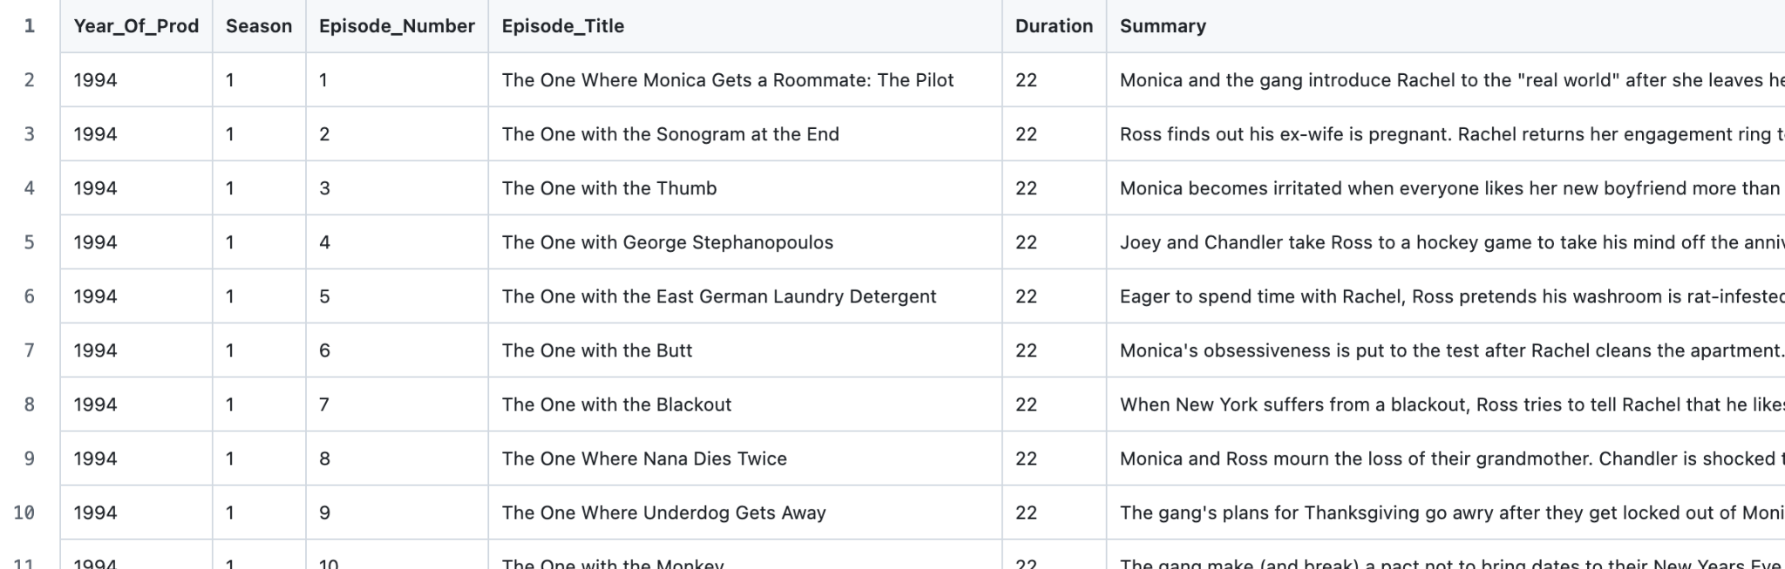
EDA Dataset
Dataset Overview
What is included?
friends_episodes_v3.csv
The dataset is sourced from Kaggle, contains all the necessary data needed including year of production, seasons, episode number, episode title, duration, and a brief summary

Slide 4
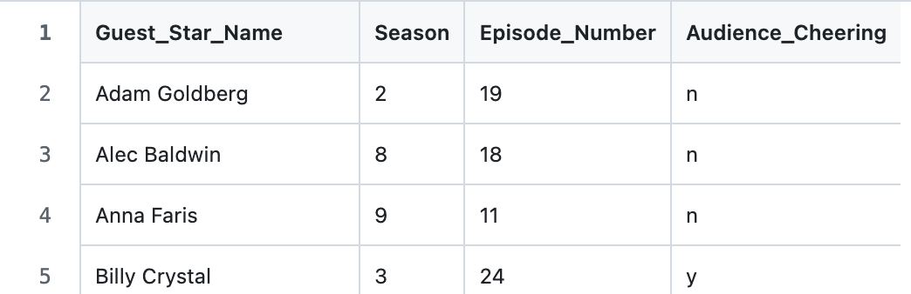
EDA Dataset
Dataset Overview
What is included?
guest_stars_info.csv
The guest star dataset is collected manually, the data include the name of the star in the episode, the season number, the episode number, and whether the audience cheered or not when the star appears

Slide 5
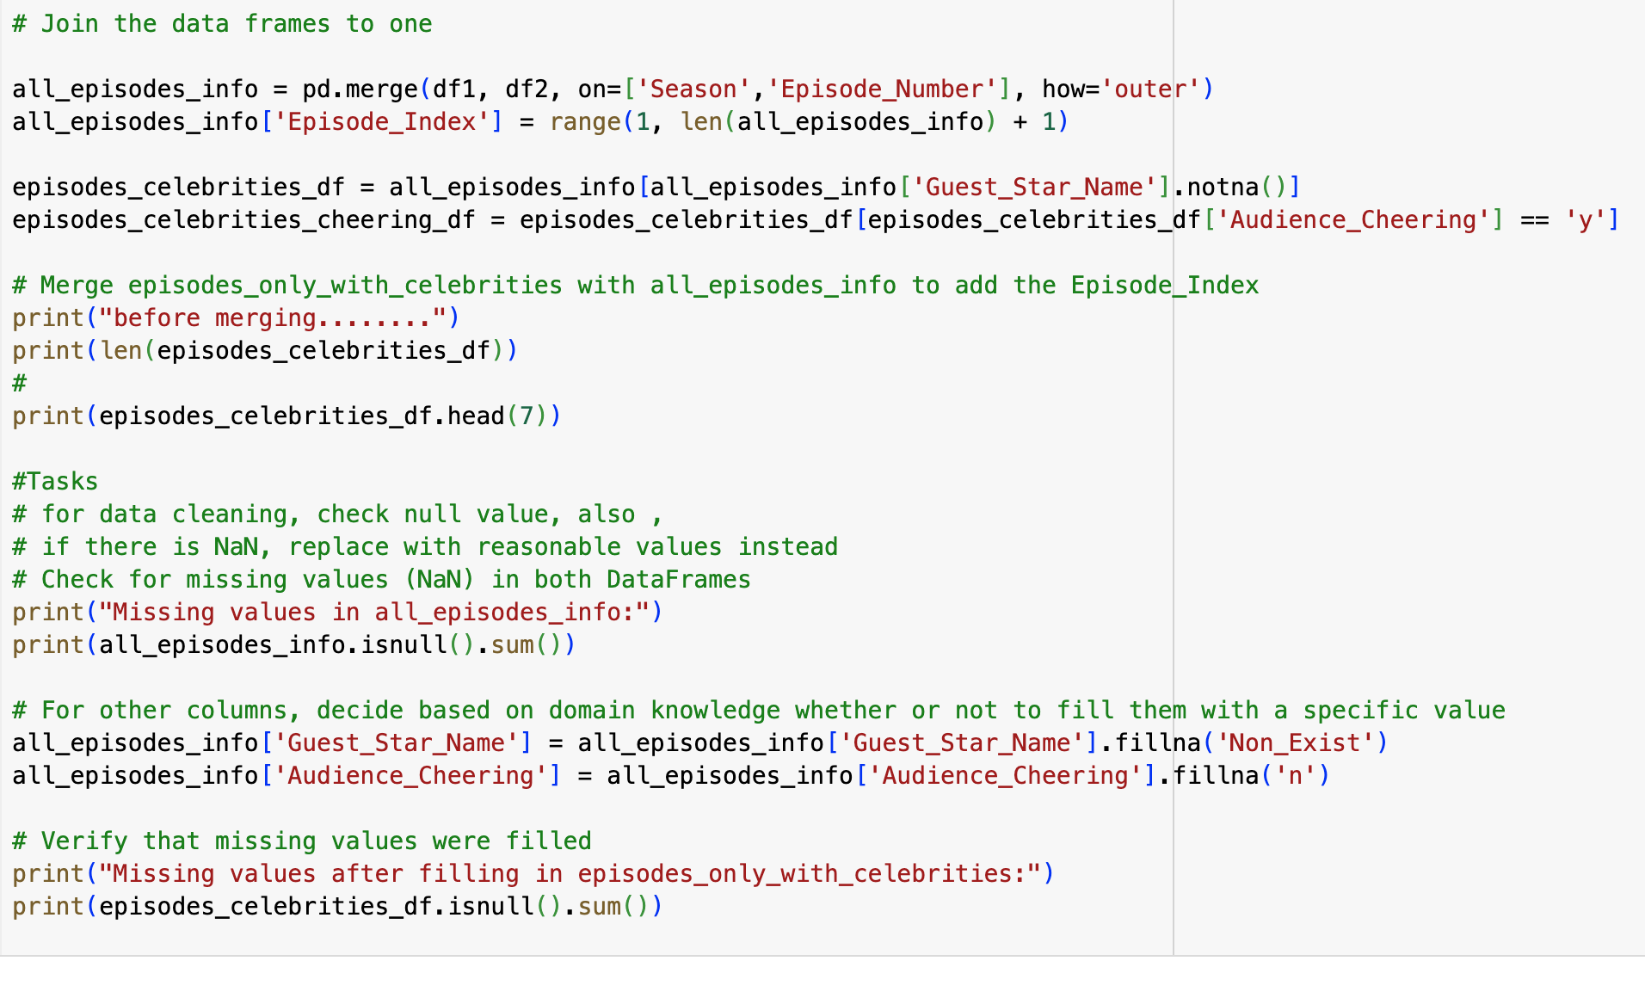
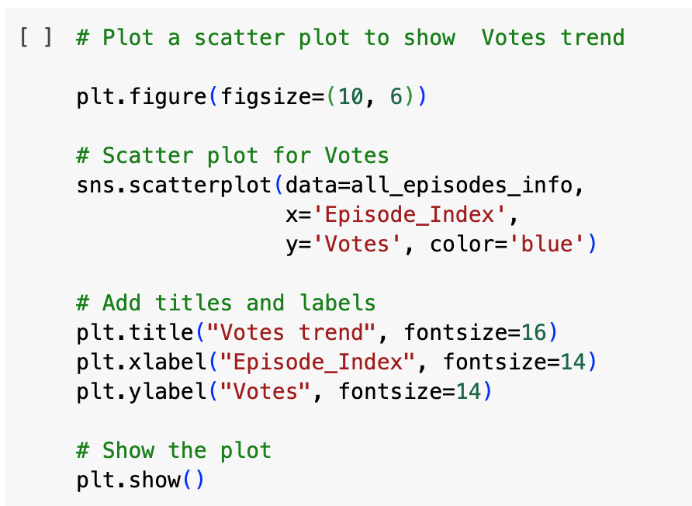

What did the code cover?
Code Walk
EDA
Finding data
Concatenating and cleaning data
Analyzing data
The initial step is doing research and sourcing the dataset online. In this case, our dataset was harvested from Kaggle.
To ensure clean data, missing values were filled with reasonable defaults, making the dataset complete and ready for further exploration
Then, here’s an example of one of the analysis. This code generates a plot that visualizes the trend of audience votes across all episodes of Friends.

Slide 6
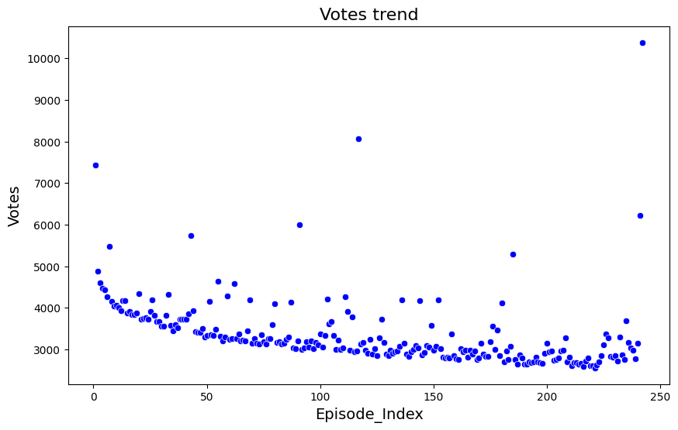
Data Visualization
Sample Analysis
IMDb votes trend
Represent the total number of users who rated a particular episode, indicating its popularity or engagement level.

Slide 7
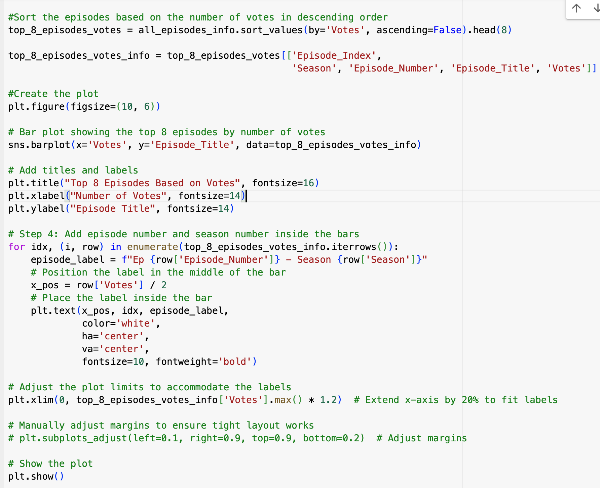
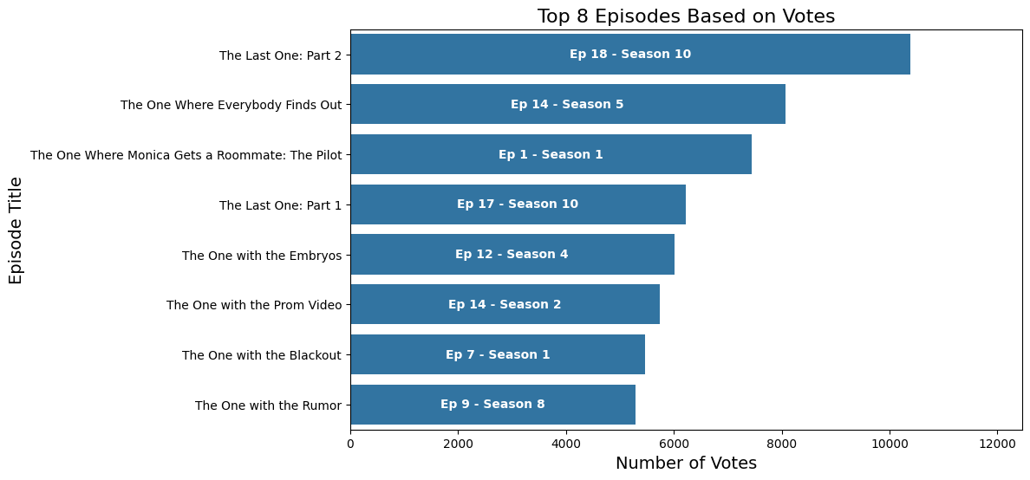
Data Visualization
Sample Analysis
Top 8 Episodes based on IMDb votes

Slide 8
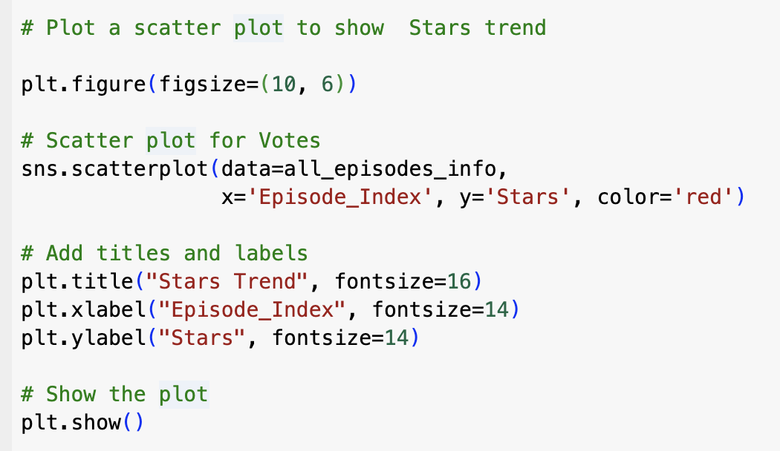
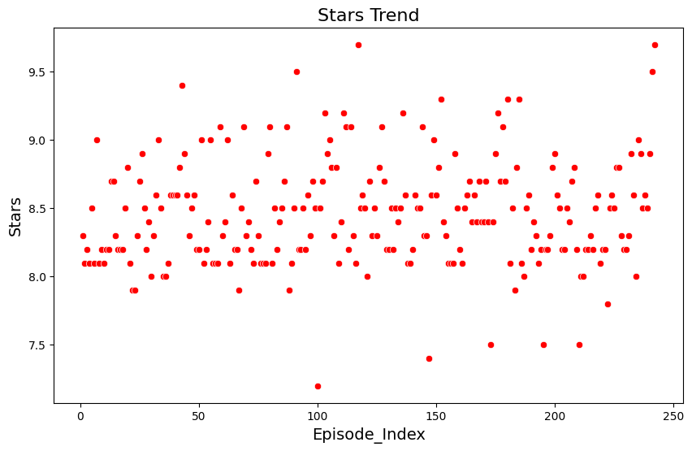
Data Visualization
Sample Analysis
IMDb star trend
Represent the average rating given by users on a scale of 1 to 10, reflecting the perceived quality or audience enjoyment of the episode.

Slide 9
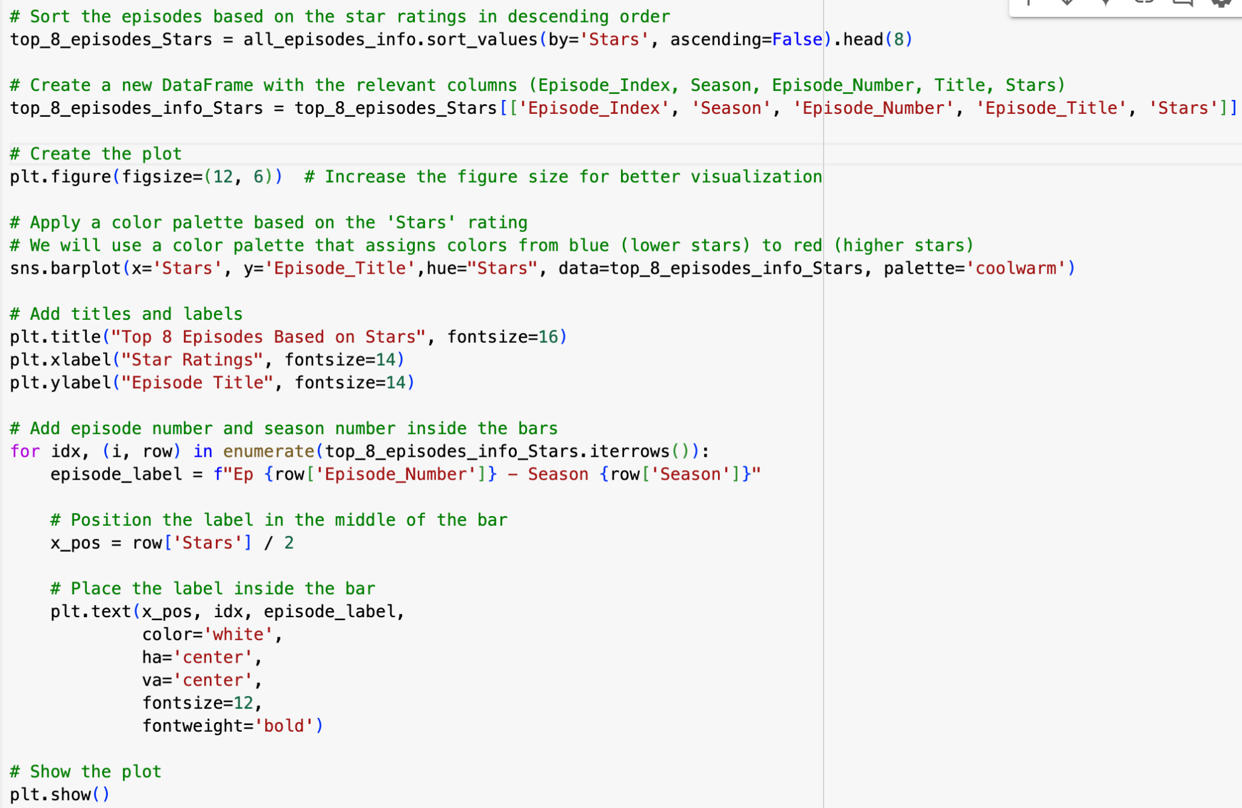
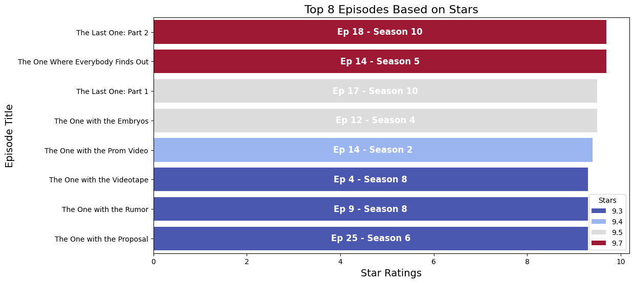
Data Visualization
Sample Analysis
Top 8 Episodes based on IMDb stars

Slide 10
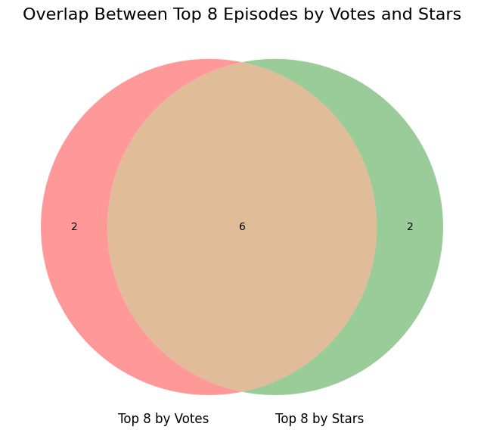
Overlap Between Top 8 Episodes by Votes and Stars
Sample Analysis
The overlap indicates episodes that are both widely watched and well-liked, showing a general agreement between popularity and quality

Slide 11
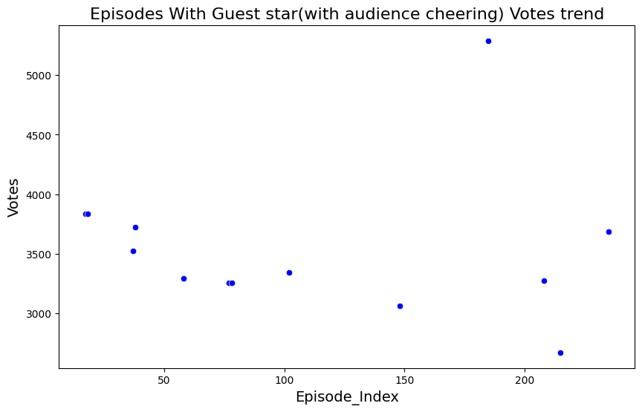
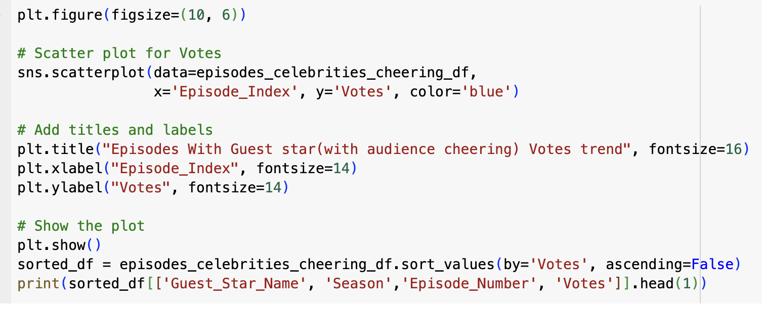
Guest Star Votes Trend
Season 8, Episode 9
Who is the guest star?

Slide 12
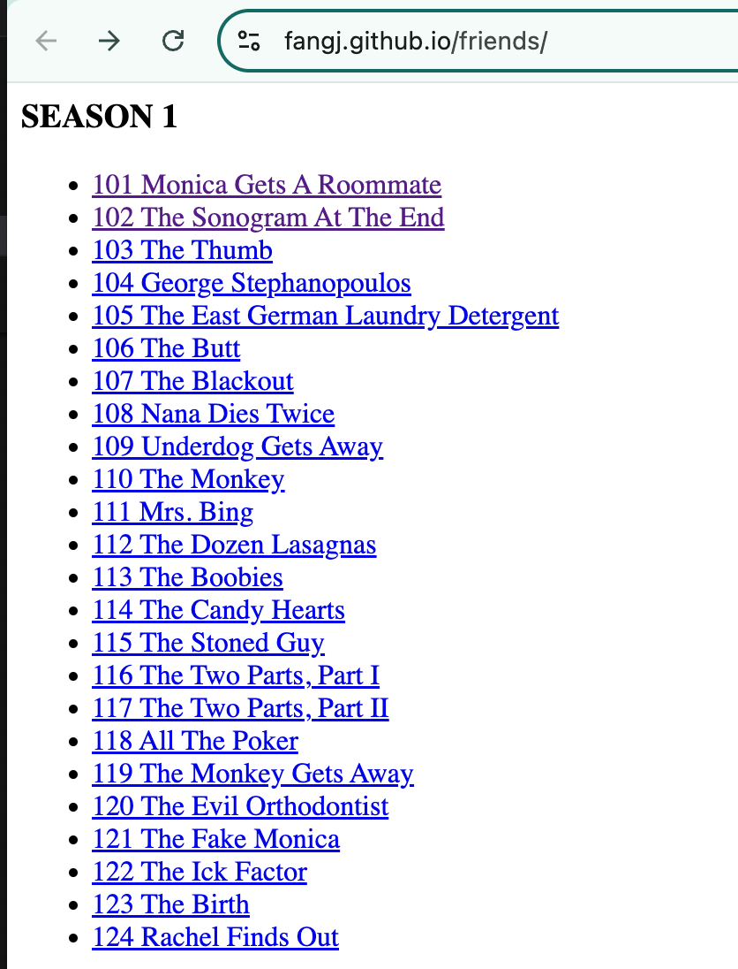
Script Analysis
Data Scraping Collection from https://fangj.github.io/friends/
Data Cleaning
lines analysis
Sentiment analysis

Slide 13
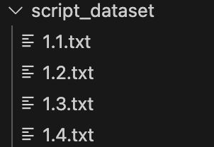
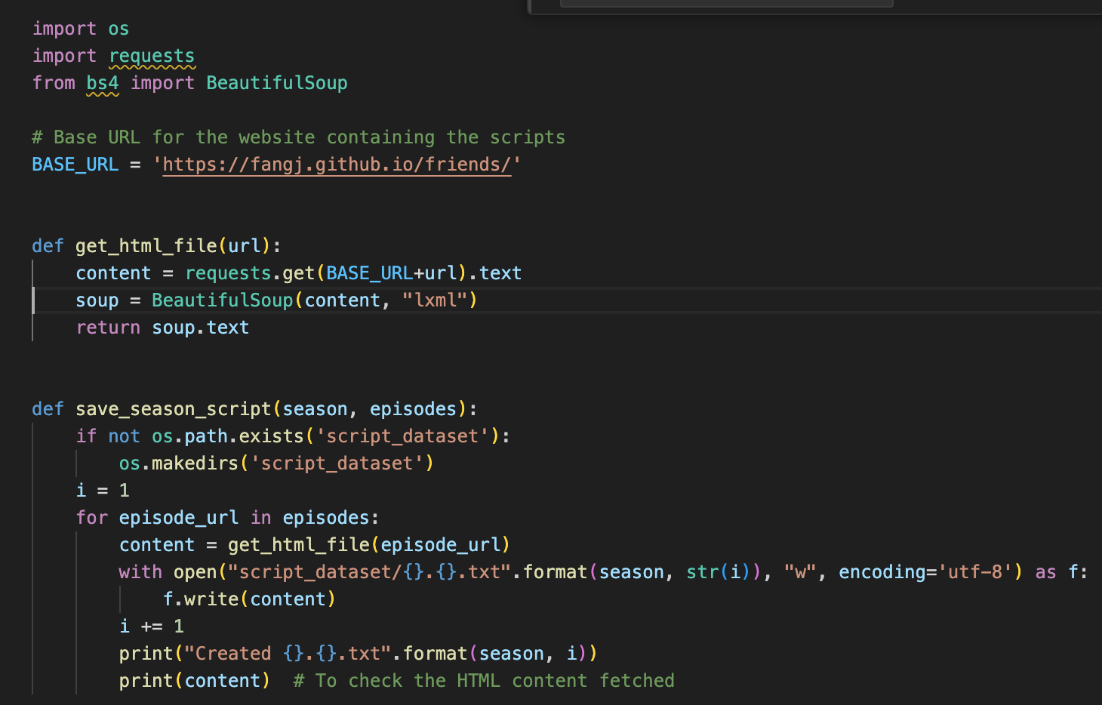
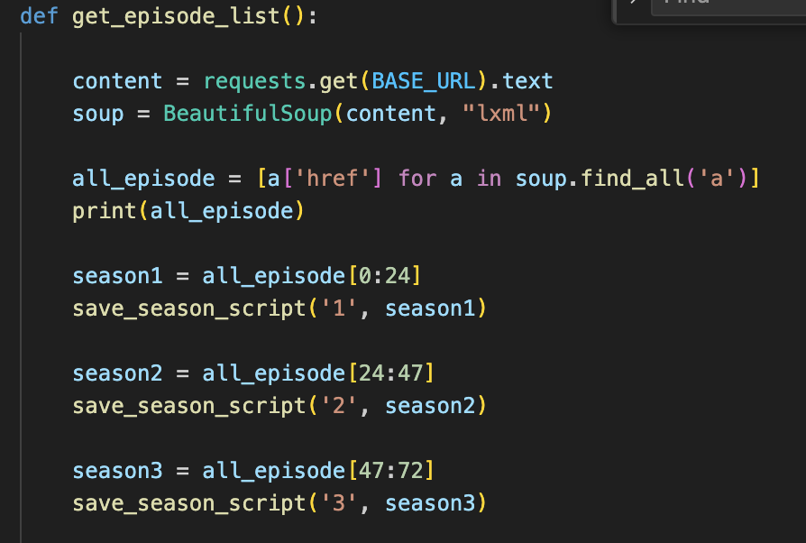
Data Collection
Use the BeautifulSoup library to scrape all the nested links inside this page
go to each individual page, extract all the text from the HTML page, and then save the text
get_episode_list() method will make a get request to the page containing all the episodes dialogues.
Then find all the href tags inside the HTML using BeautifulSoup. Next, iterate through all the episode links, get the text data, and then save it to the script_dataset/ directory.
no

Slide 14
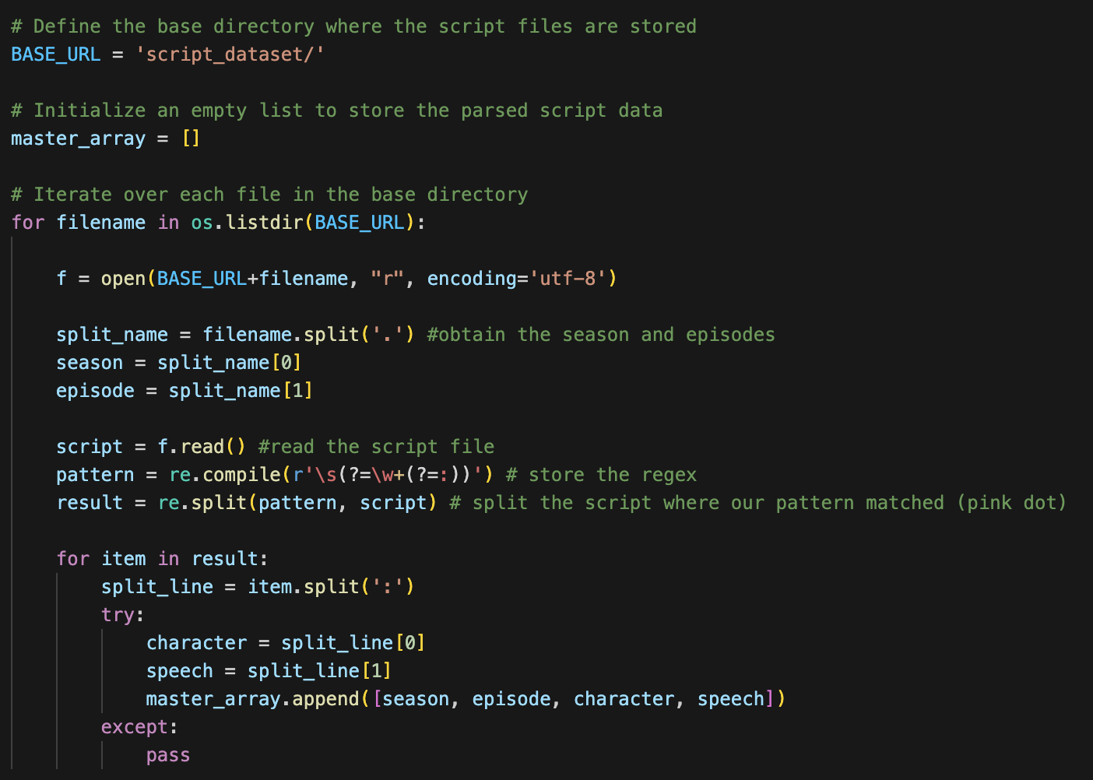
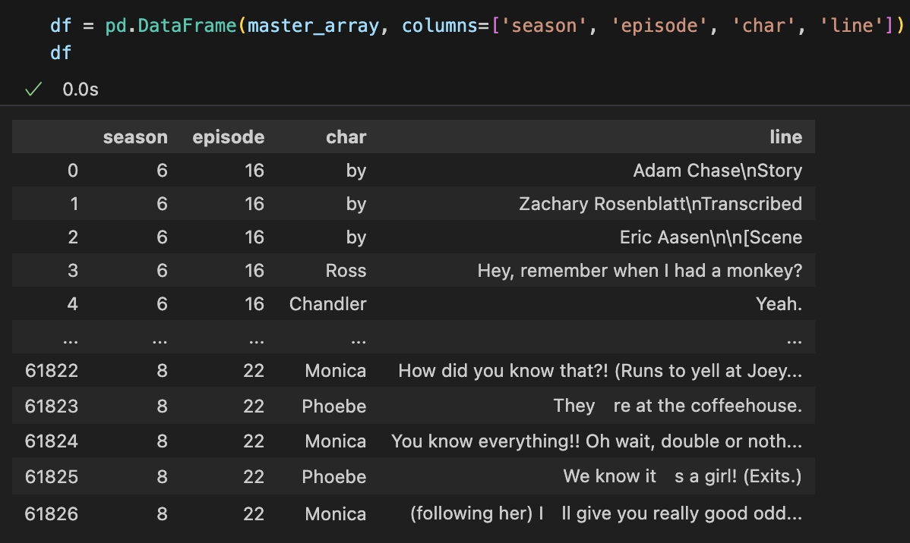
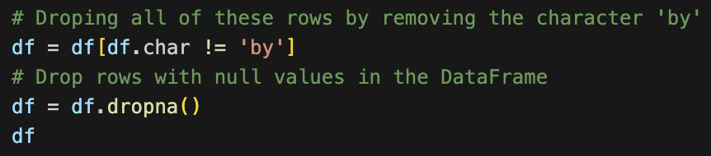
Creating DFs & Cleaning
Loops through all script files in the specified directory (BASE_URL) and extracts season and episode numbers from filenames.
Reads the script content and uses a regular expression to split dialogues by character names.
Extracts and stores season, episode, character, and speech information into a master_array for further analysis.

Slide 15
Take a guess –
Which character speaks the most lines?

Slide 16
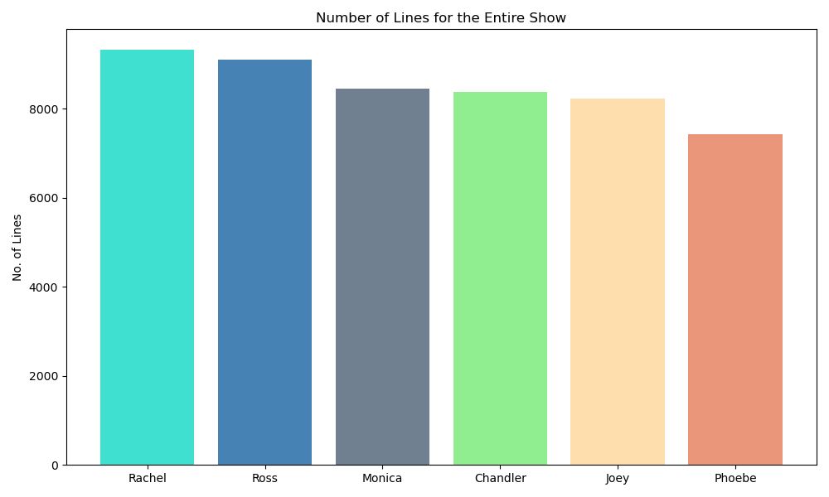
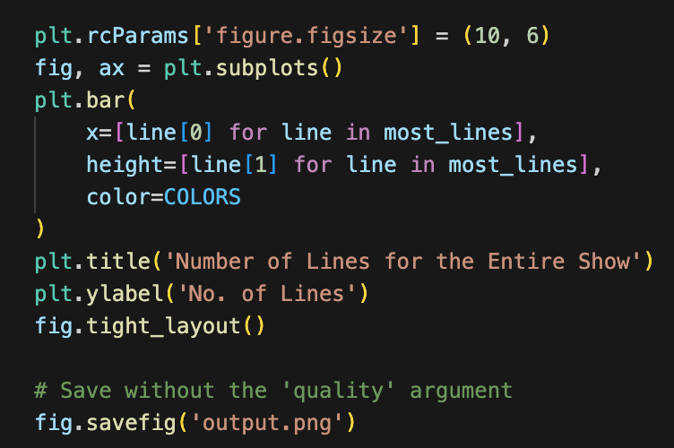
The Most Nosy Friend
The number of lines spoken in the entire show by character

Slide 17
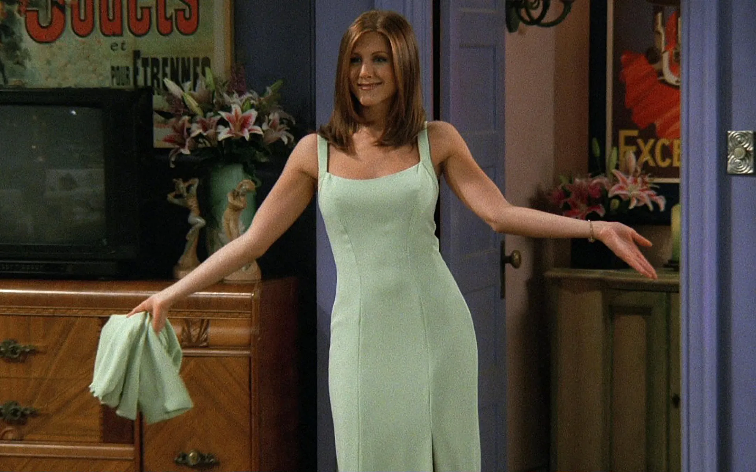

Slide 18
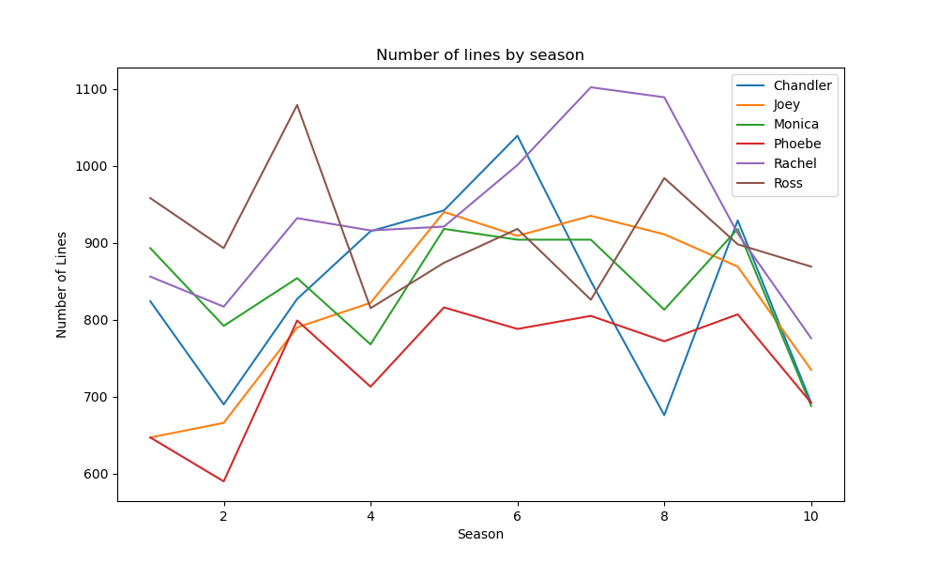
Number of Lines by Season
The number of lines spoken in each season by character

Slide 19
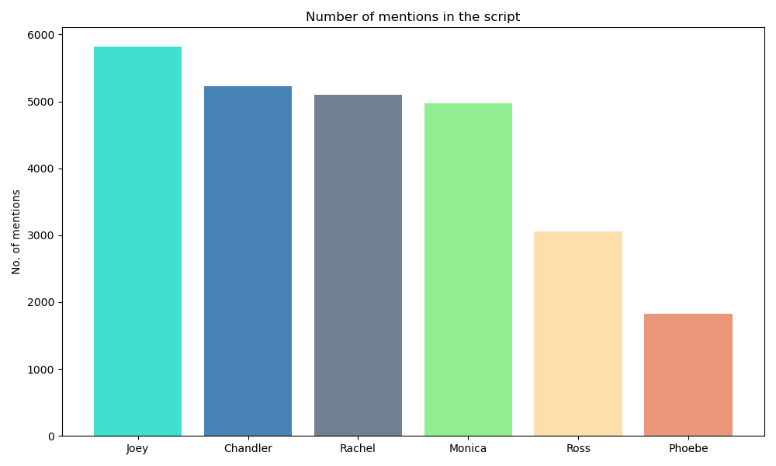
The Most Popular Friend
The most spoken about character

Slide 20


Slide 21

Ross’s sentiment analysis

Slide 22
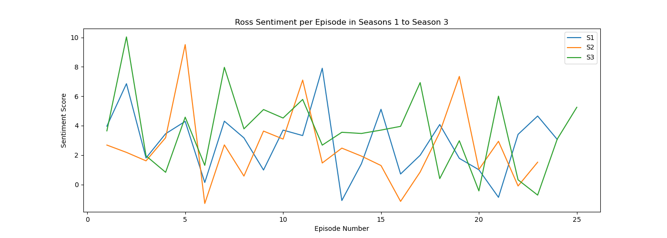
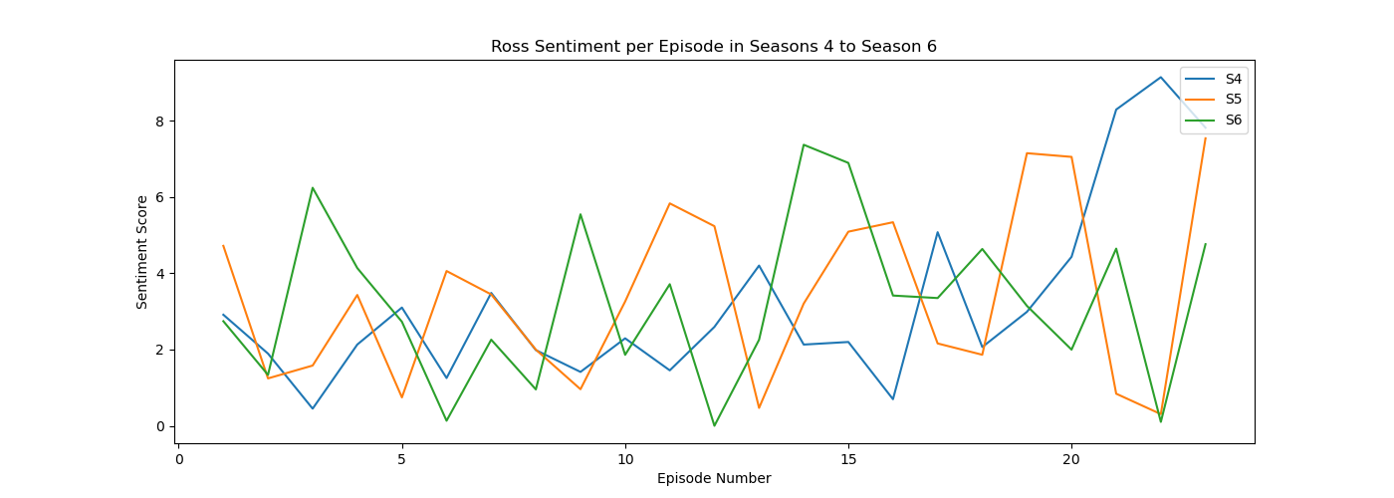
Ross’s Sentiment all Seasons
Sentiment analysis was used to evaluate the emotional tone of Ross's dialogue across episodes and seasons.
Each line of dialogue was assigned a sentiment score, typically ranging from negative to positive.
These scores were then aggregated by episode to observe trends and identify emotional highs and lows in Ross's character throughout the series
Our code processes Ross's dialogue lines, assigns each line a sentiment score using a pre-trained sentiment analysis tool, TextBlob, and stores the results in a sqlite database. It then aggregates these scores by episode, allowing for trend analysis of Ross's emotional tone across the series.
Notes:
The code processes Ross's dialogue lines, assigns each line a sentiment score using a pre-trained sentiment analysis tool, and stores the results in a database. It then aggregates these scores by episode, allowing for trend analysis of Ross's emotional tone across the series.

Slide 23


